Slide 1
Spiers centre anniversary
Memories of granny spiers

Slide 2
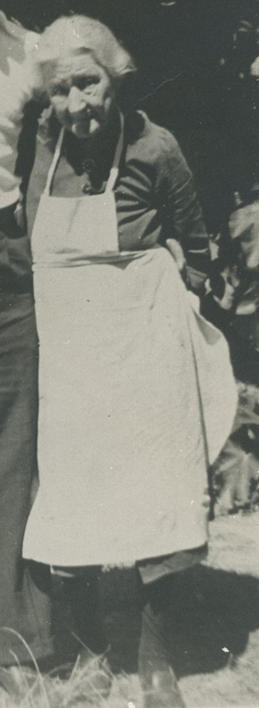
Frances (Granny) Spiers 1862 - 1950
Frances Sophia (Granny) Spiers (nee Boughton) was born on Feb 4, 1862, in Learmonth Victoria.
Her parents were Anne Boughton (nee Clarke) and William Boughton.

Slide 3
Frances (Granny) Spiers 1862 - 1950
Frances Sophia Boughton married James Spiers in February 1883, just after Frances’ 21st birthday.
James and Frances Spiers had four children:
Robert, b. 1884
William, b. 1887, (killed in an accident age 4)
Frances Sophia, b. 1890 (known as Fanny)
James, b. 1893 (called Jockey Jim by the family)
William, b. 1896 (called Barlow by the family)

Slide 4
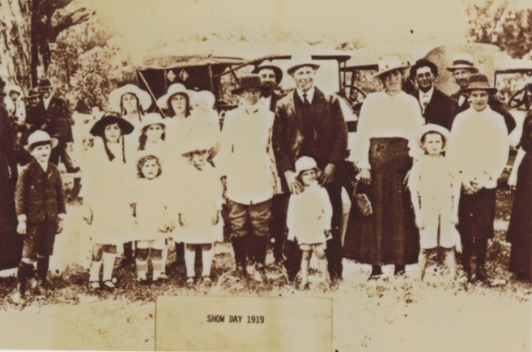
Frances (Granny) Spiers 1862 - 1950
Granny Spiers was known far and wide for her hospitality, generosity and kindness. Friends, locals and travellers were all welcomed with open arms and a loaded table. Local children would descend on her kitchen table after school for cakes and biscuits.
All the kids (including her own) would call her Granny Spiers.
Granny organised the children’s competition events at the annual Wanneroo Agricultural Show and ensured every child who entered would win a prize.
Picture Wanneroo Collection, Image PD03439; reproduced courtesy of Wanneroo Regional Museum

Slide 5
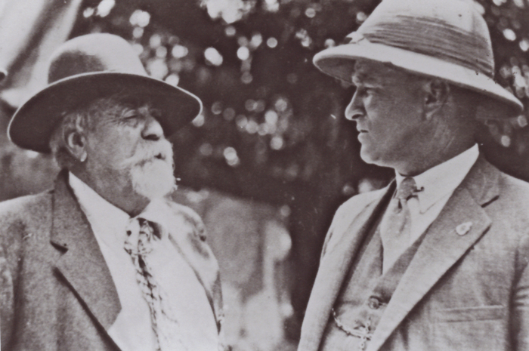
James (Jasper) Spiers
James (Jasper) Spiers was born in Launceston, Tasmania in 1857 and his family migrated to Victoria when he was 14 years of age. He arrived in Fremantle in 1894 at the height of the gold rush and rapidly recognised the opportunity for advancement.
He later brought his wife Frances Sophia Boughton and family from Victoria and set up as a cartage contractor, being responsible for much of the road works around Kalgoorlie’s Golden Mile. At one point, James had a lease on the island in the middle of Lake Joondalup.
Picture Wanneroo Collection, Image PD03456; reproduced courtesy of Wanneroo Regional Museum

Slide 6
building a community
James and Granny were gregarious by nature. As soon as they moved in a steady stream of visitors started.
Neighbours and friends were not greeted over the front fence – everyone was brought in and given a cup of tea.
This was the secret of Granny’s popularity as a hostess: people were never allowed to feel like outsiders or acquaintances, but rather valued friends and even part of the family.

Slide 7
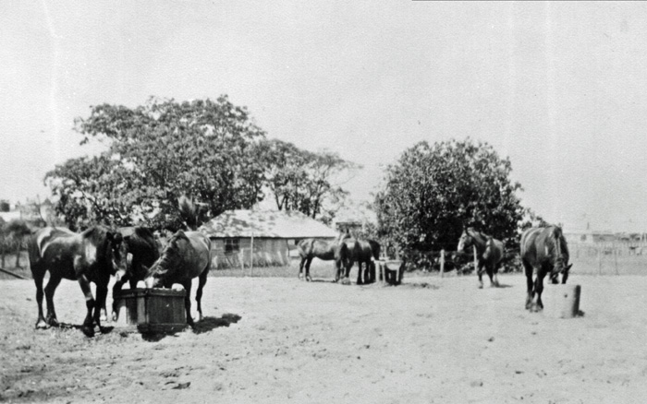
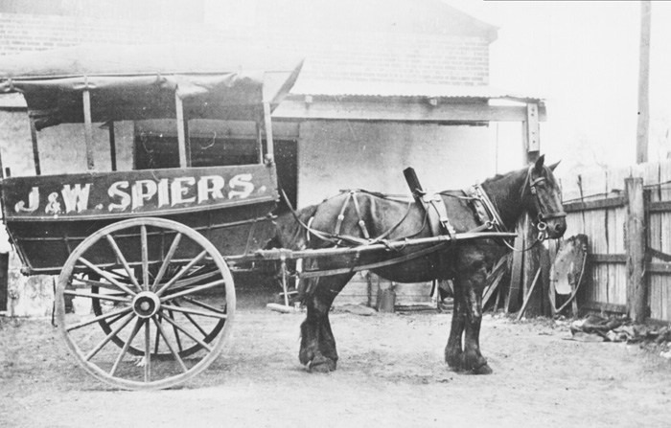
1900 - 1905
The family moved to Wanneroo in 1905, into a house at the present day Wanneroo Showgrounds near Lake Joondalup. The property was part of the Wanneru Estate, and the land was bought mainly to spell horses used in James’ haulage business.
PD00781: Horses feeding at Spier's property at the 15 Mile peg, Wanneroo Road now Ariti Avenue, Wanneroo.
The Spiers owner land for grazing cattle around Lake Joondalup (known then as Craigie Lake).
Picture Wanneroo Collection, Image PD00781; reproduced courtesy of Wanneroo Regional Museum
Picture Wanneroo Collection, Image PD00216; reproduced courtesy of Wanneroo Regional Museum

Slide 8
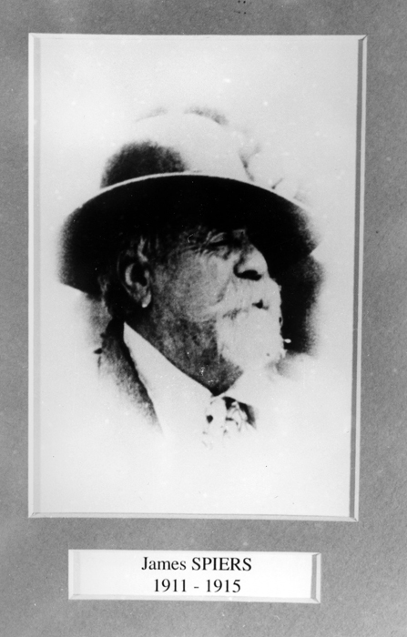
1911
James Spiers served the Central and North Wards of the Wanneroo Roads Board for 10 years in 3 terms between 1908 and 1923.
A Wanneroo Road Board Member from 1908-1925, 1920-1923 in the Central and North Wards, and second Chairman of the Board 1911-1955.
Picture Wanneroo Collection, Image PD00346; reproduced courtesy of Wanneroo Regional Museum

Slide 9
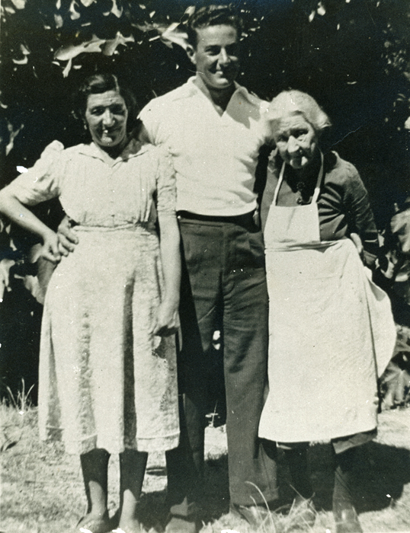
1940
The Spiers and Ariti families were neighbours at the 15 Mile, Wanneroo, for many years. Granny Spiers helped Rosaria with her English while they took in walks.
Rosaria often asked Granny for advice on things such as medical problems. It was Granny who helped Charlie Ariti when he badly injured himself on a tree stump.
Picture Wanneroo Collection, Image PD03180; reproduced courtesy of Wanneroo Regional Museum
Rosaria and Rosario Ariti and Frances (Granny) Spiers.

Slide 10
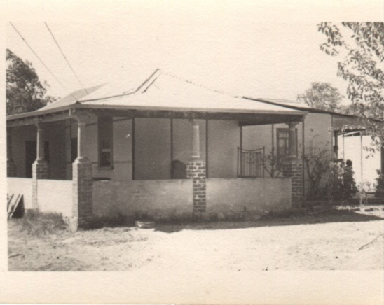
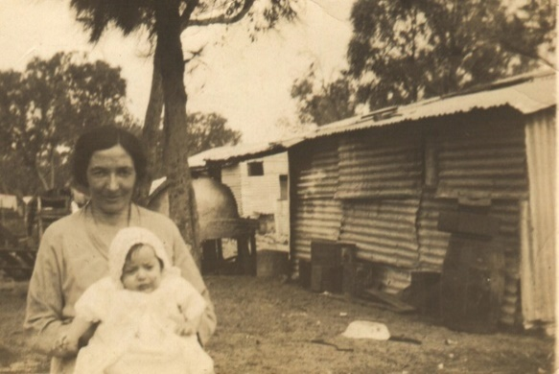
1940
Along with so many other children from the Wanneroo area, the Ariti children spent a lot of time at the Spiers house.
They would fight over who would take Granny gifts of cauliflowers and cabbages, as the person who did would almost certainly receive a piece of cake or something delicious to eat.
PD00025: Ariti family home
PD00026: Rosaria and Lucy Ariti

Slide 11
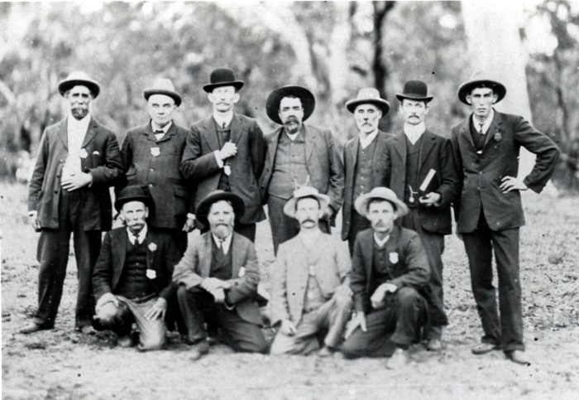
Wanneroo agricultural society
The inaugural committee was responsible for the running of the first Wanneroo Show held on 21 April, 1909.
The show was held on five acres just off the 15 Mile peg, Wanneroo Road.
James was the first president of the Wanneroo Agricultural Society and became a life member in 1930.
Picture Wanneroo Collection, Image PD00719; reproduced courtesy of Wanneroo Regional Museum
Kneeling left to right: J. Steele, E. A. Caporn, E. Duffy, R. S. Cockman.
Standing left to right: D. H. Lillingston, Dr. E. J .A. Haynes, A. Edwards, J. Spiers (President), H. Hocking (Treasurer), F. J. Duffy (Secretary), C. M. Cockman.

Slide 12
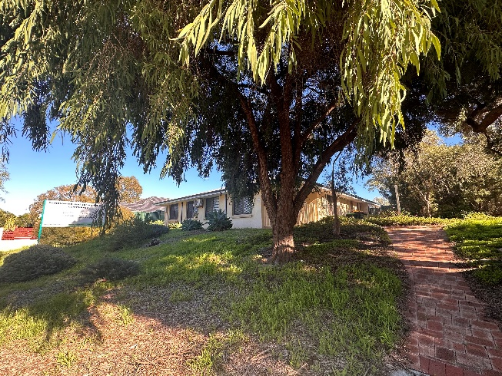
1980s
The Spiers Centre (formerly Granny Spiers Community House) was named in honour of Frances, as she was “actively involved in all local community activities and her home was open to the community and travellers alike”.

